Slide 1
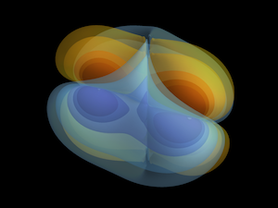
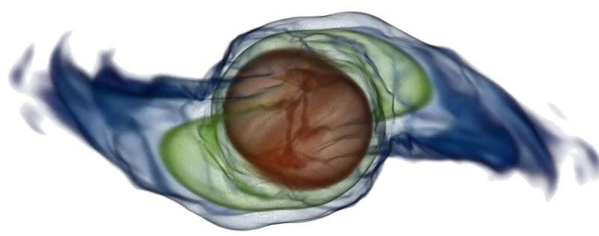
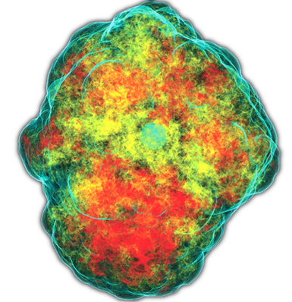
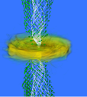
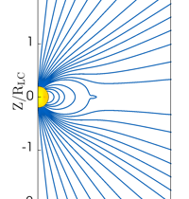
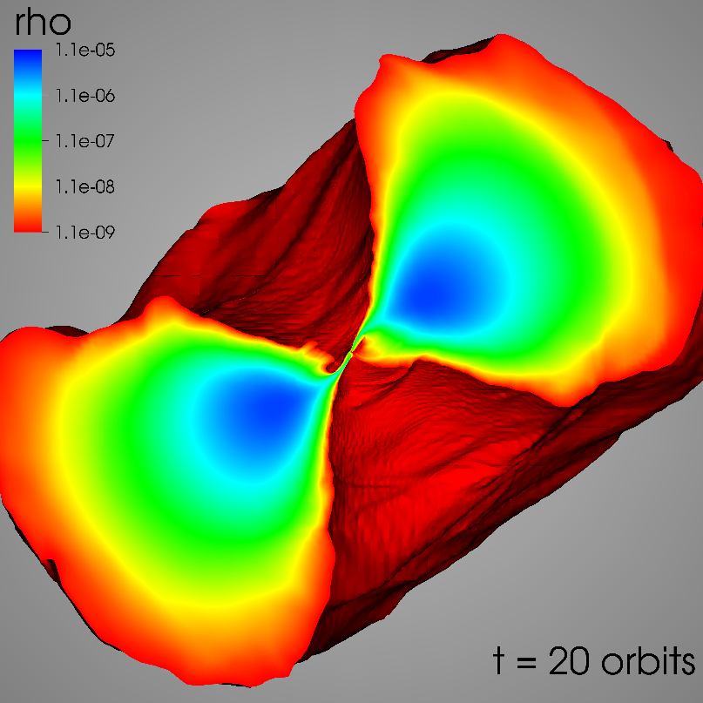
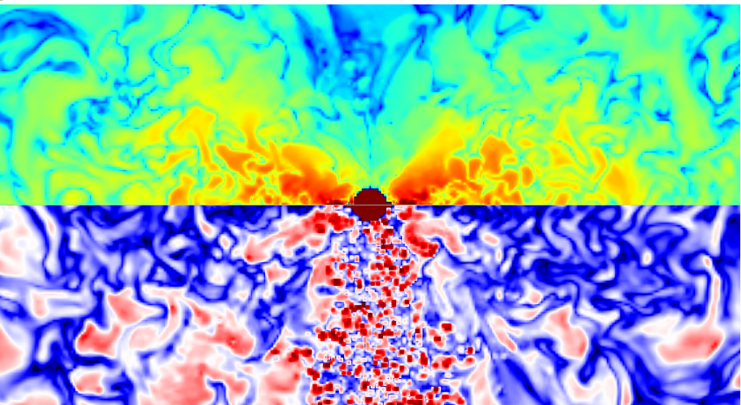
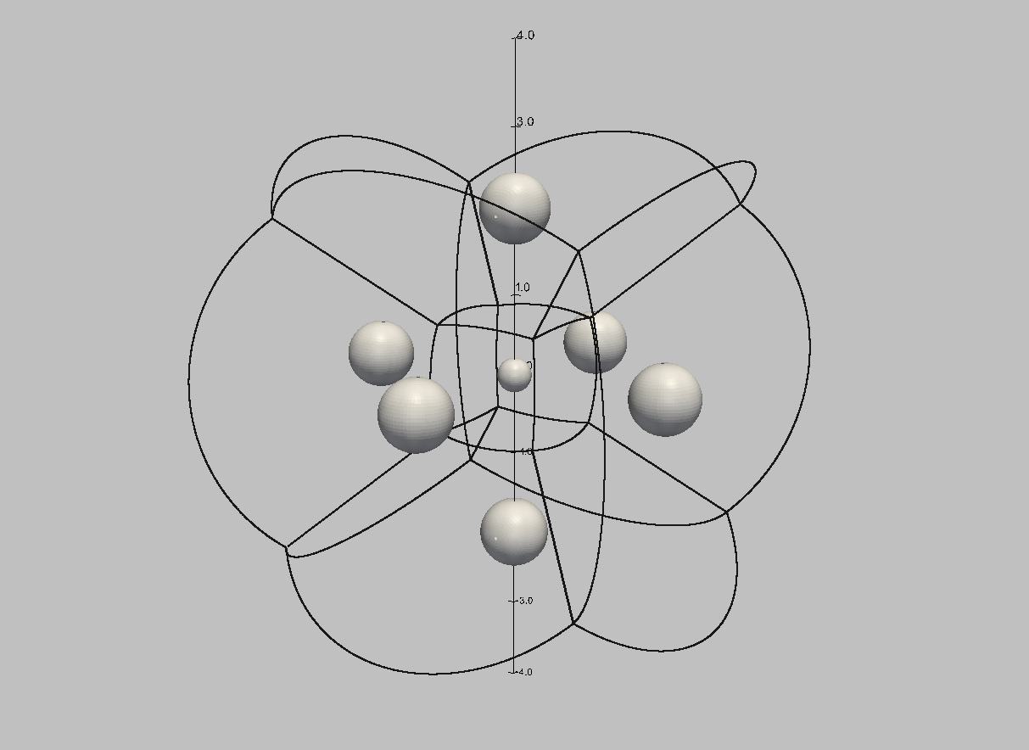
Einstein toolkit based results
binary black hole mergers
binary neutron star mergers
mixed binaries
supernovae
accretion disks
boson stars
cosmology
GRMHD simulations
2 free, open source, mature codes for ideal MHD simulations
force-free MHD code available
support for tabulated hot EOS
neutrino transport: leakage and M1 moment scheme
fully dynamic gravity solver
B. Wardell
R. Haas
C. Ott
M. Ruiz
D. Siegel
Z. Etienne
E. Bentivegna
V. Mewes

Slide 2

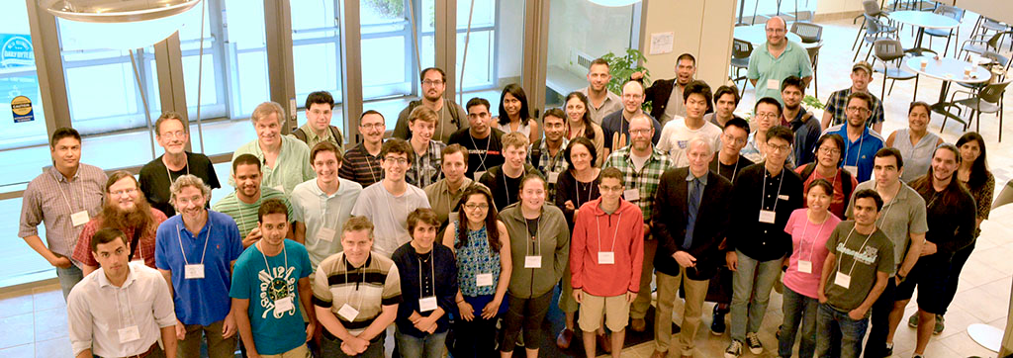
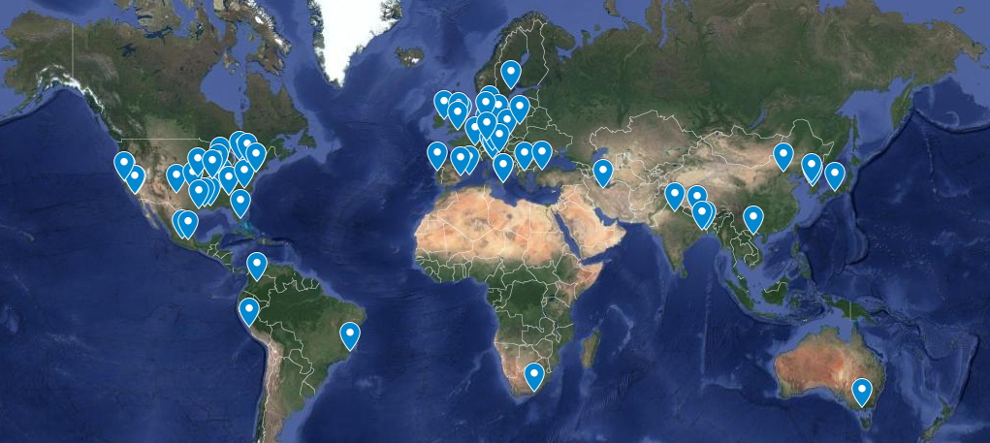

113 users on 6 continents!
http://www.einsteintoolkit.org

Slide 3
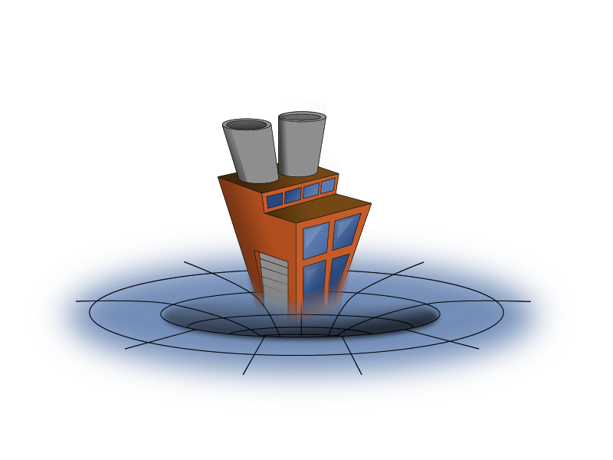

Einstein toolkit
Goals
community-driven
mailing list
wiki, bug tracker
core computational tools for relativistic astrophysics and gravitational physics
Components
Cactus thorns for GW science
Simulation factory
GetComponents component retrieval tool
Kranc
Waveform analysis
Guiding principles
Open, community-driven software development
Well thought out and stable interfaces
Separation of physics software from computational science infrastructure
complete working production codes
does not itself develop codes
codes are proposed for inclusion, then reviewed
must be of current interest for the community

Slide 4
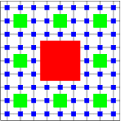






Open source framework
Decentralized code development
Active and friendly user community
Gordon Bell price in 2001
Infrastructure modules
Parameter file handling
Parallelization (MPI + OpenMP)
Mesh refinement
IO and checkpointing
Physics modules
Spacetime evolution
General relativistic radiation magnetohydrodynamics
Multigrid elliptic solver

Slide 5
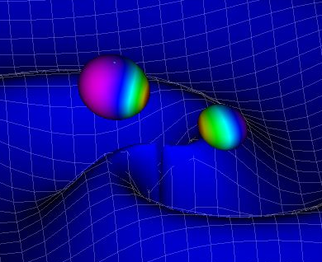
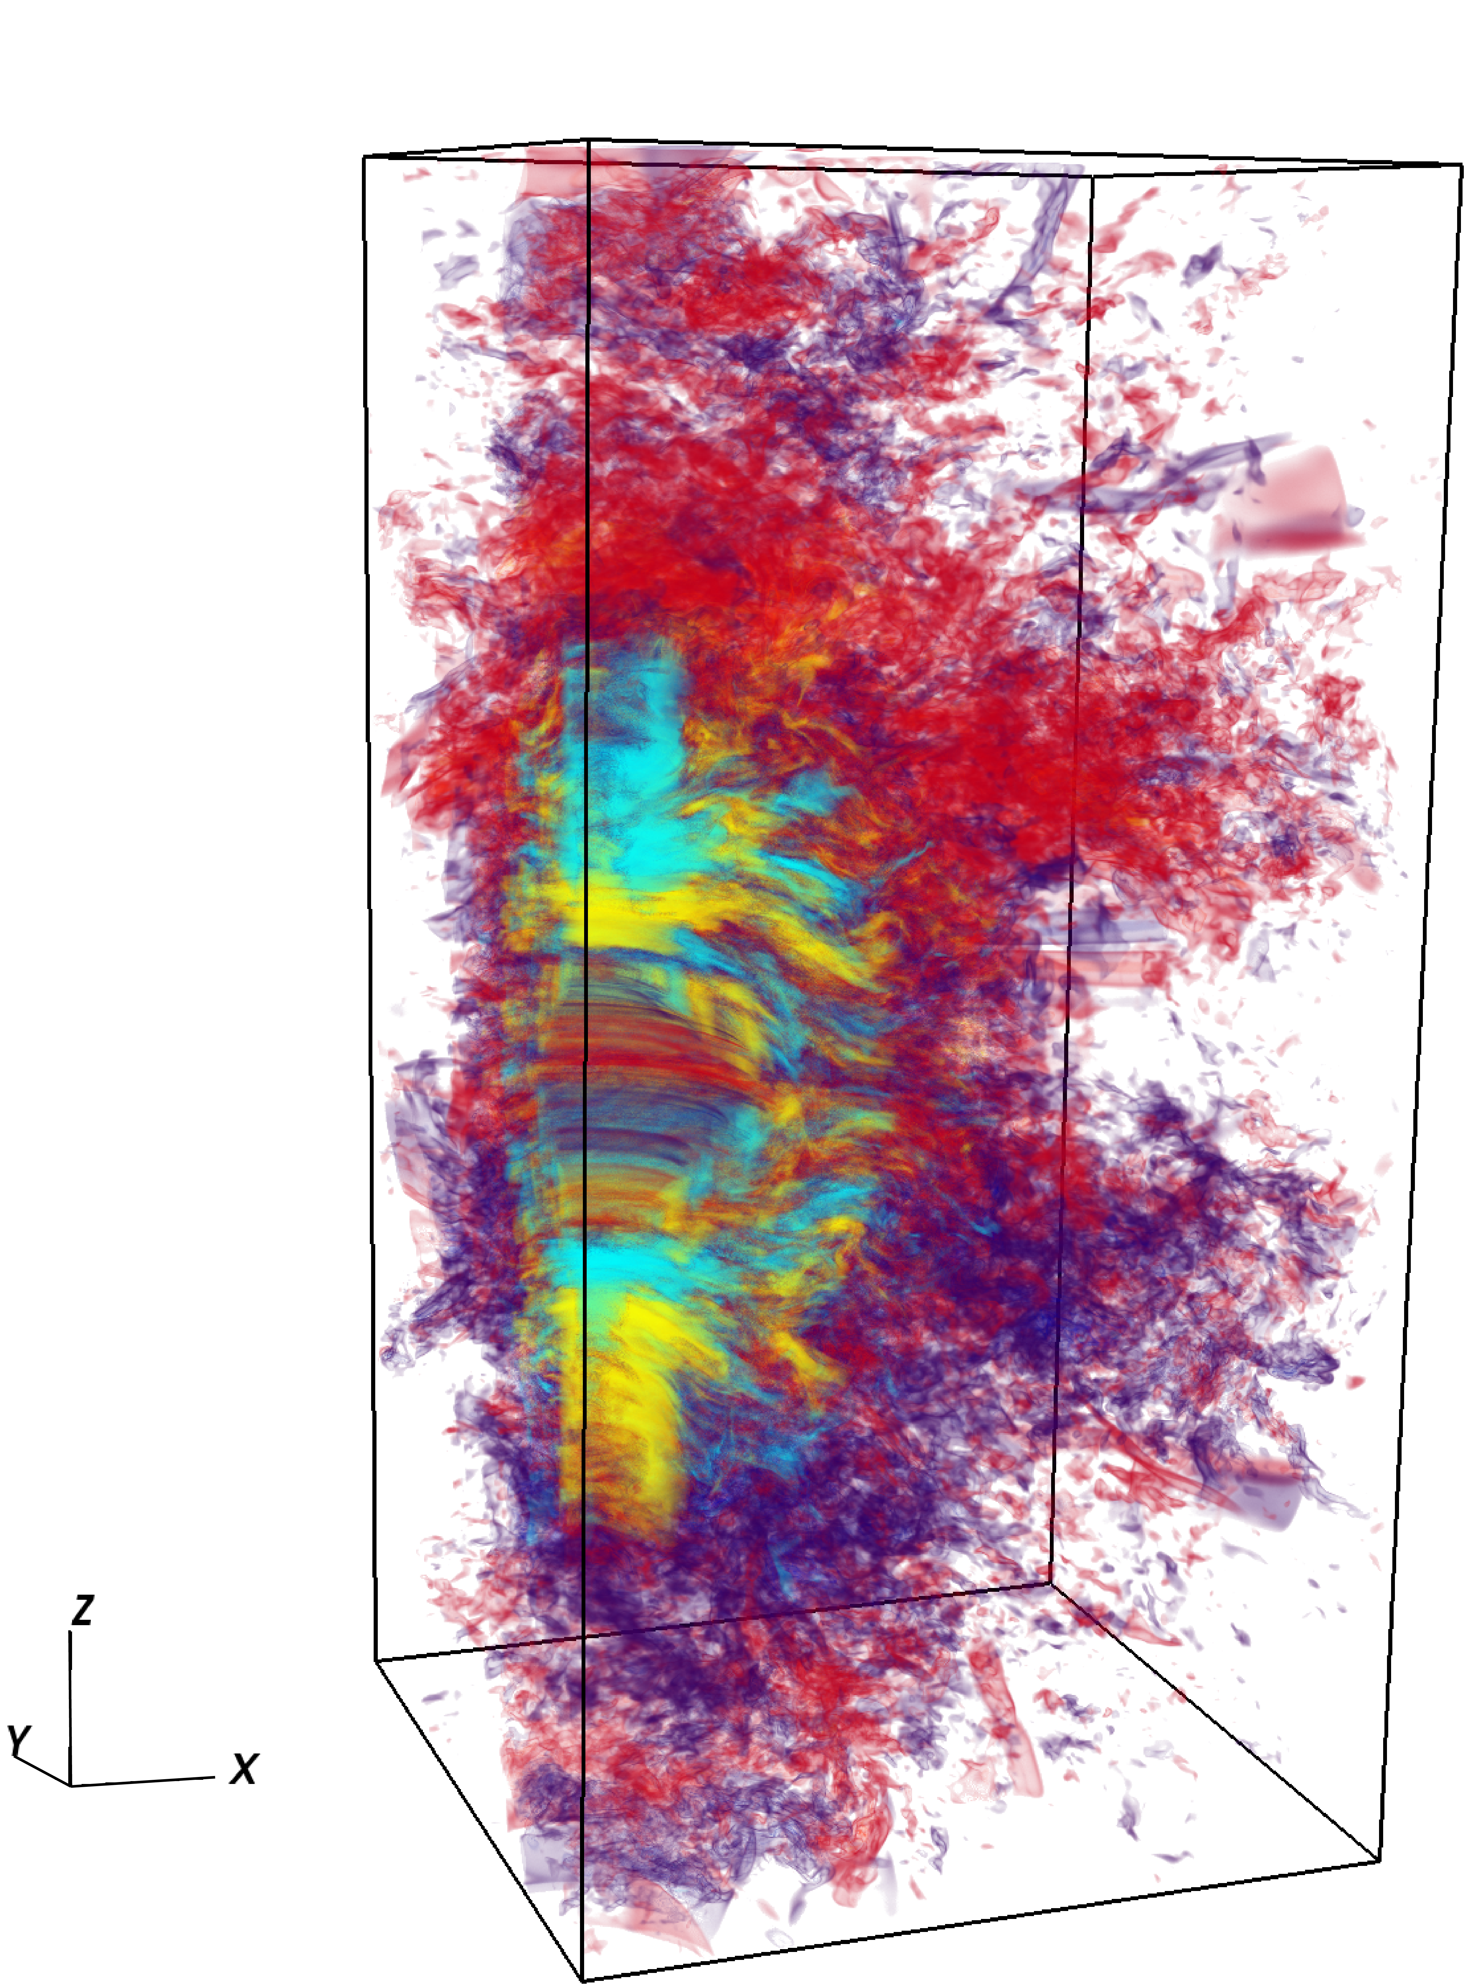
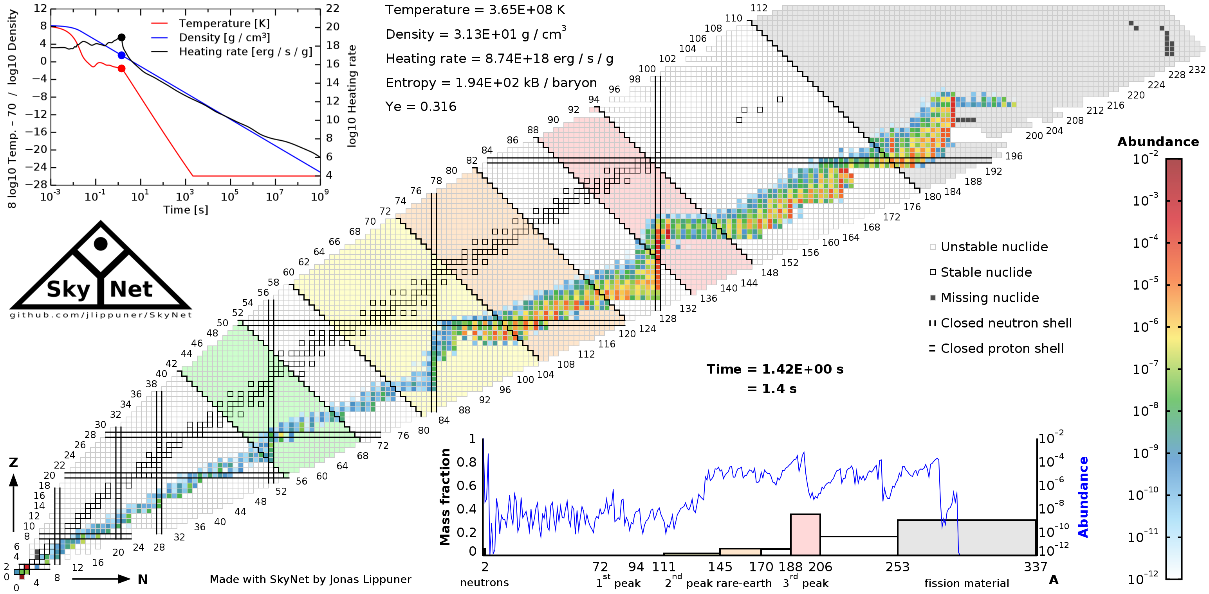
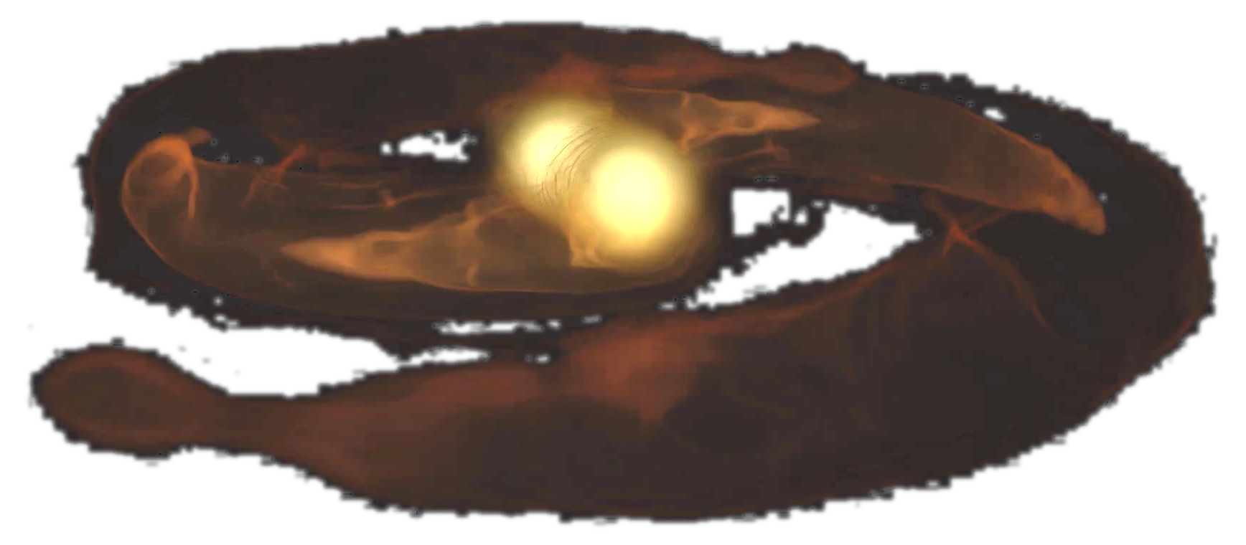
multi-physics problems
numerical general relativity
magnetohydrodynamics
neutrino radiation transport
nuclear physics
vast range of scales
hundreds of milliseconds for final merger
possibly seconds to collapse
turbulent scale in disk and contact layer
accretion disk around remnant
gravitational wave zone
R. Haas
J. Lippuner
P. Moesta
S. Rosofsky

Slide 6
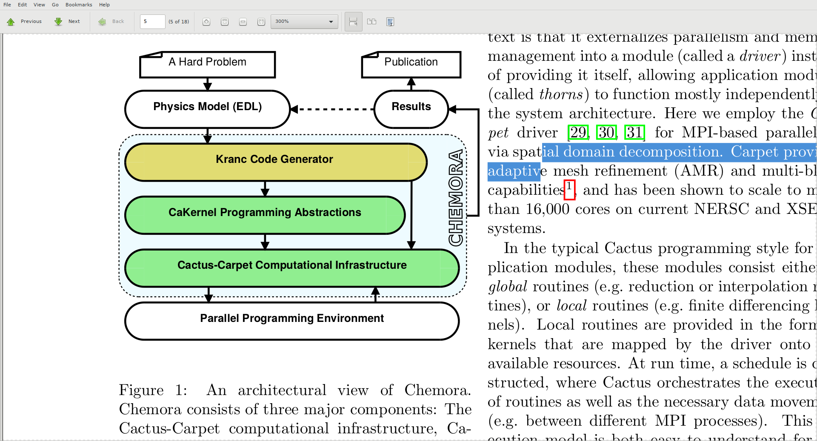
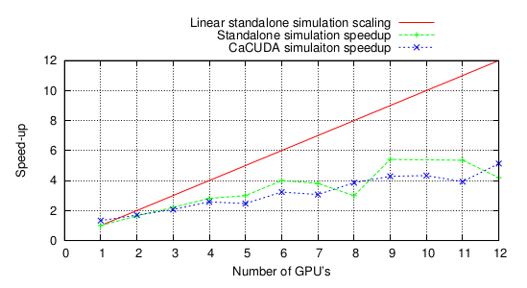
New compute architectures
Many core architectures and GPUs required different code strategies than classical CPUs
Chemora: high level code generation for GPUs
M. Blazewicz
speed comparable to hand optimized code
faster tuning than runtime measurement due to model based approach
M. Blazewicz

Slide 7
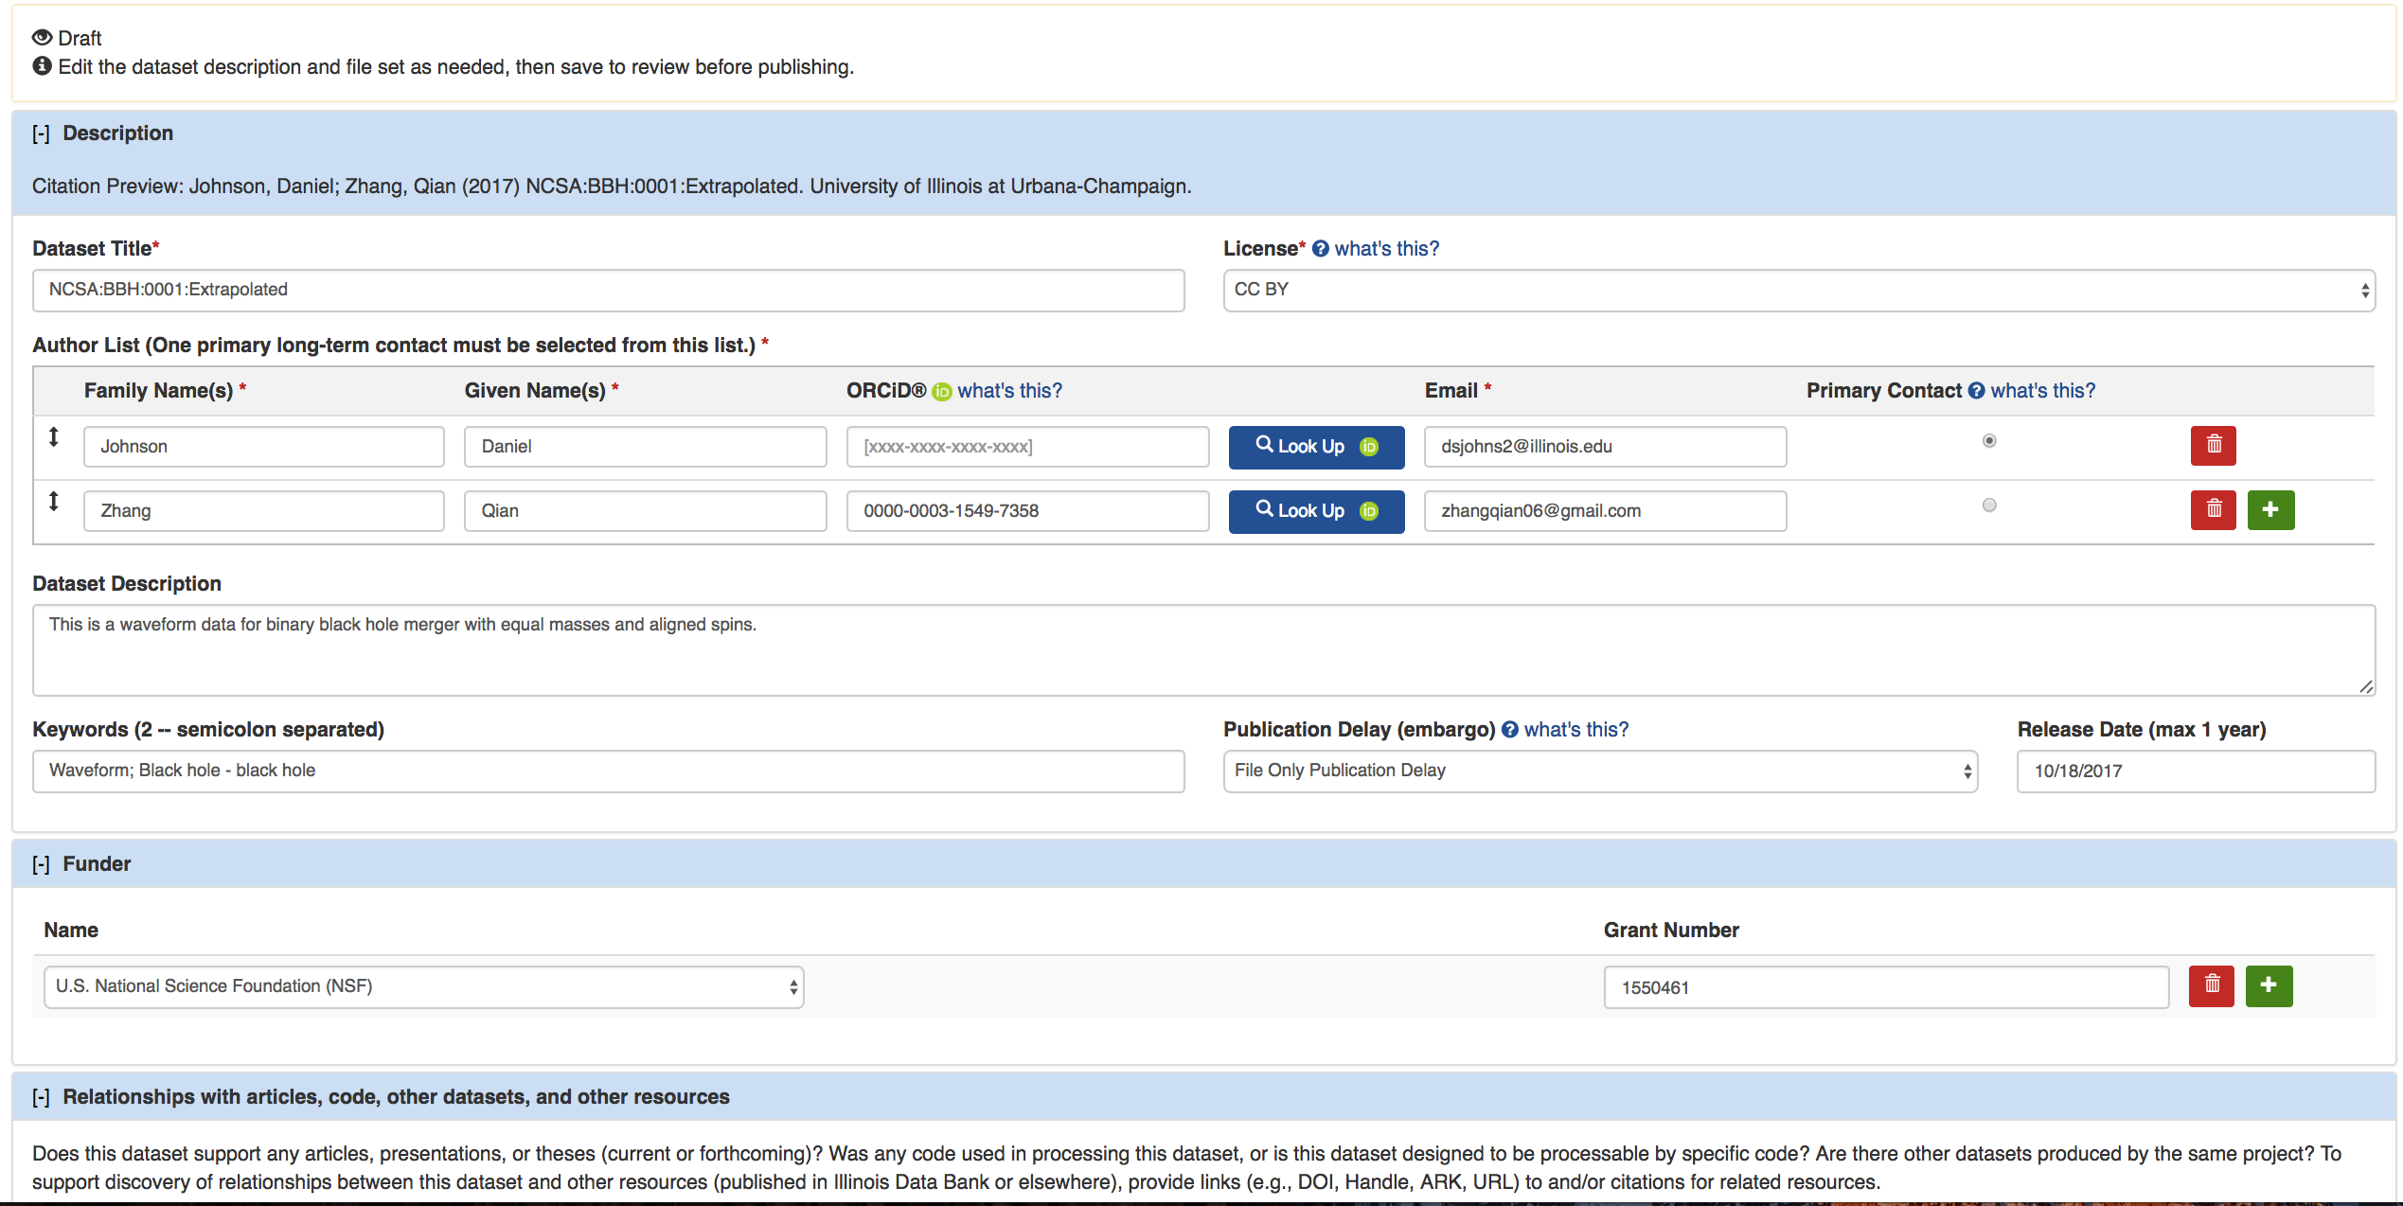
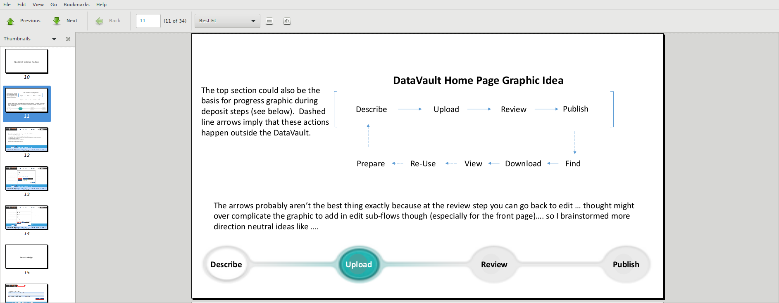
DataVault
simulation data repository
waveforms
initial data
equations of state
simulation snapshots
features
searchable
persistent, data provenance
citable (DOI)
open license for data
why a new database?
domain-specific
community-centric
huge dataset(s)
interactive analysis
online visualization
Q. Zhang
Q. Zhang

Slide 8
Future of the Einstein Toolkit
Science drivers
Infrastructure needs
Black hole waveforms for LIGO
Double neutron star / BH - NS waveforms for LIGO
Dynamical and optical properties of the large-scale Universe
GR+X modified gravity. I.e., boson fields.
Core collapse supernovae
Ejecta from NS-NS mergers
Jets! RMHD.
improvement of efficiency and load balancing
Task based parallelism
user-friendly tools for generating hydro initial data
Improvements to Kranc

